Slide 1
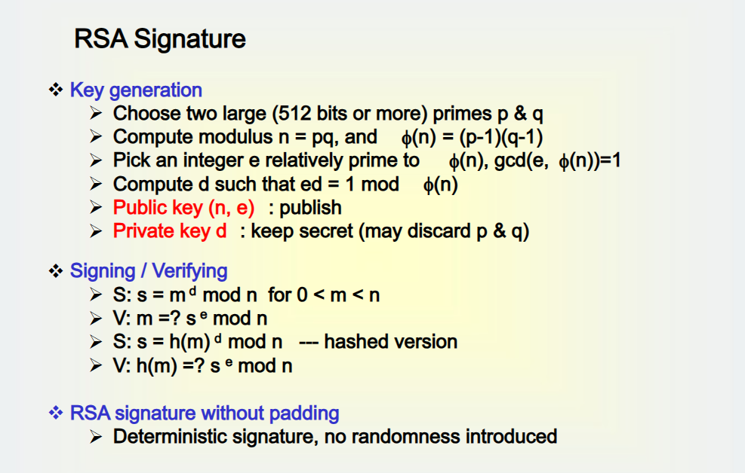

Slide 2
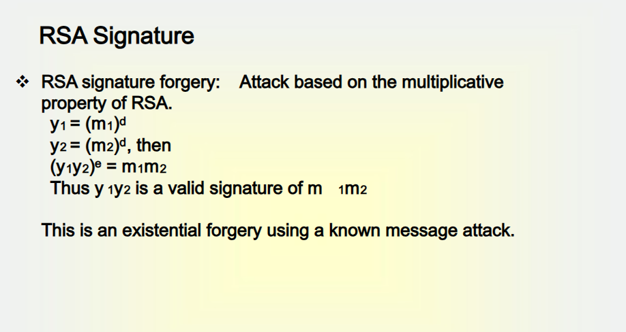

Slide 3
ELGAMAL DIGITAL SIGNATURE
As with Elgamal encryption, the global elements of Elgamal digital signature are prime number q and α, which is a primitive root of q.
User A generates a private/public key pair as follows.
1. Generate a random integer X_{A} (PK), such that 1 < X_{A} < q - 1.
2. Compute public key Y_{A} = α ^{XA} mod q.
3. A’s private key is X_{A} ; A’s pubic key pairs is {q, α, Y_{A}}.

Slide 4
User A’s Work
To sign a message M, user A first computes the hash m = H(M), such that m is an integer in the range 0 ≤m ≤ q - 1. A then forms a digital signature as follows.
1. Choose a random integer K such that 1 ≤ K ≤ q - 1 and gcd (K, q - 1) = 1.
That is, K is relatively prime to q - 1.
2. Compute S1 = α ^{K} mod q. Note that this is the same as the computation of C1 for Elgamal encryption.
3. Compute K⁻¹ mod (q - 1). That is, compute the inverse of K modulo q - 1.
4. Compute S2 = K⁻¹(m - X_{A}S₁) mod (q - 1).
5. The signature consists of the pair (S₁, S₂).

Slide 5
User B’s Work
User B can verify the signature as follows.
1. Compute V1 = α ^{m} mod q.
2. Compute V2 = (YA)^{S1} (S1)^{S2} mod q.
The signature is valid if V1 = V2. Let us demonstrate that this is so.

Slide 6
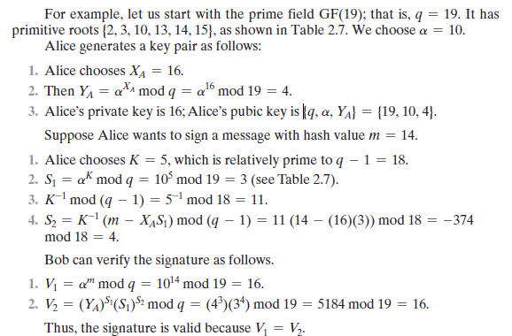
Example

